Slide 1

User Verification System

Slide 2

User Verification Methods
what you have
what you know
who you are

Slide 3
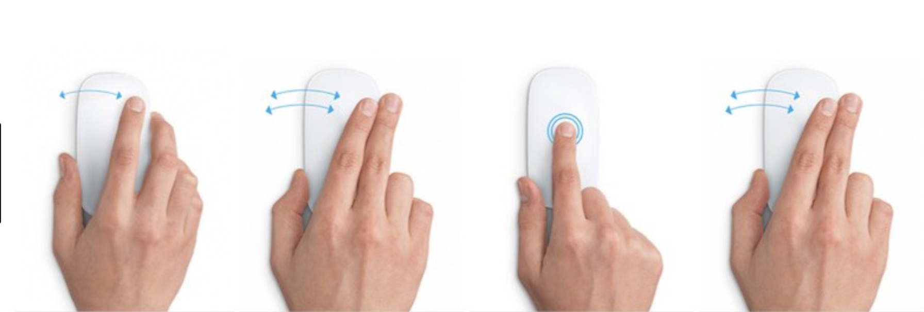
"who you are" based on
mouse movements
typing test
touchscreen test

Slide 4
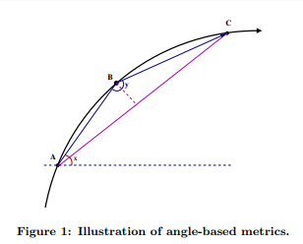
Mouse Movements Measurement
Direction
Angle of Curvature
Curvature Distance

Slide 5
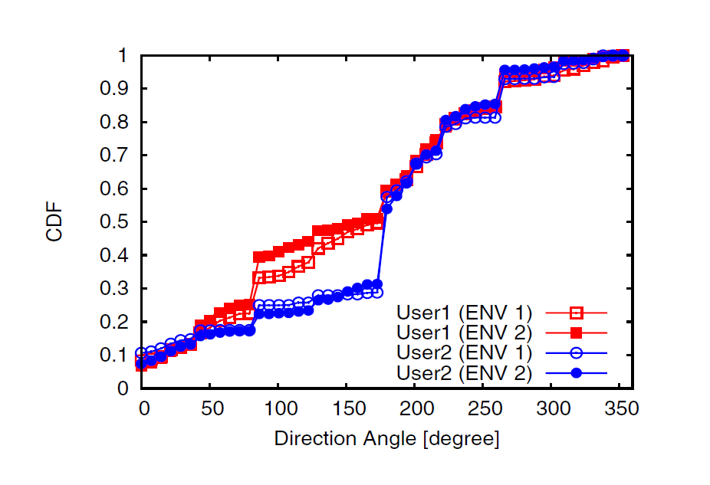
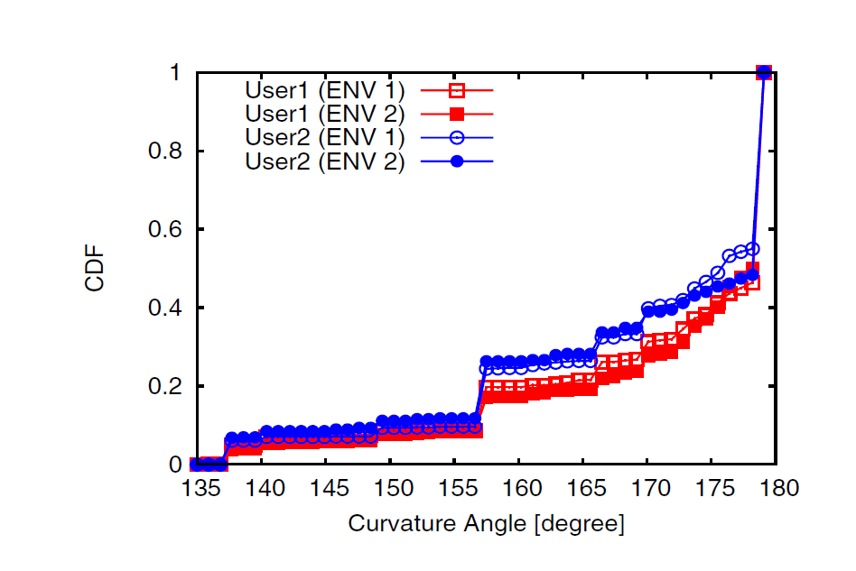
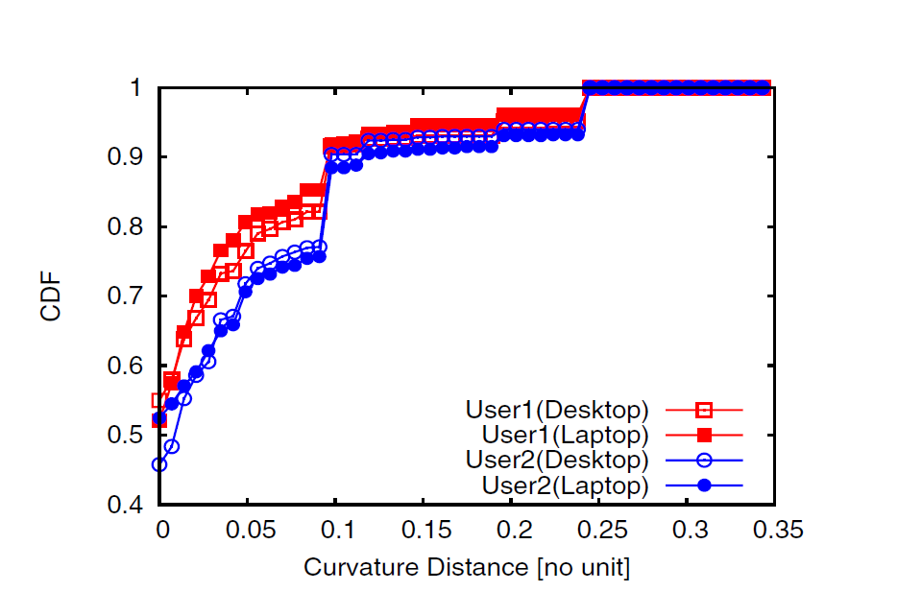
Mouse Movements Measurement
Data Collection
Data Processing
Data Metrics

Slide 6
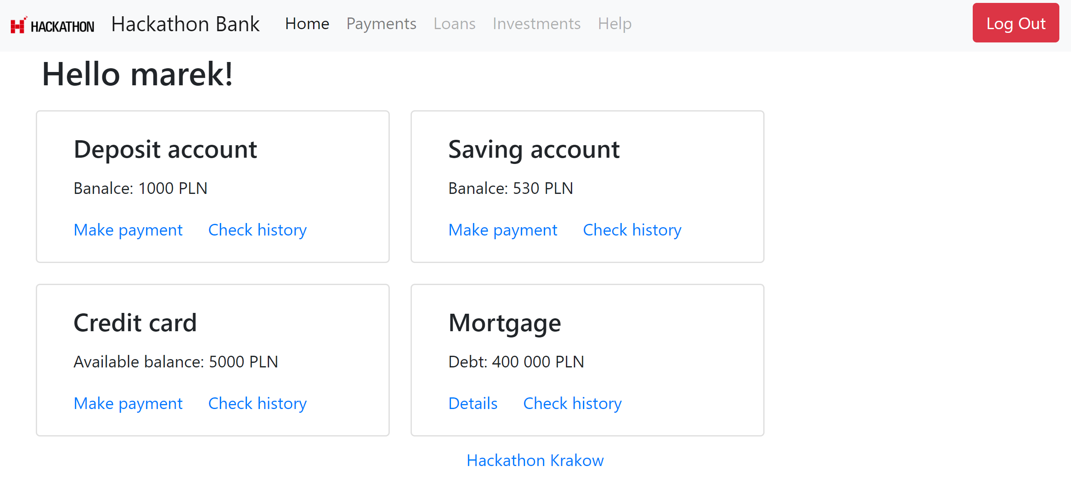
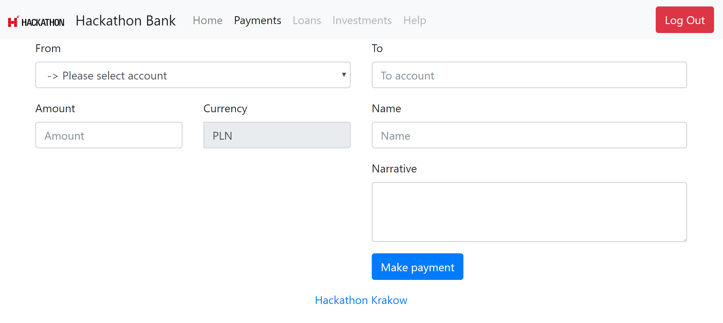
Demo

